Slide 1
Dixie Amateur Radio Club
January 2025

Slide 2
Program
Welcome
Pledge of Allegiance
Announcements
  VE Report
  Technical Report
  ARES Report
  Upcoming contests
  Other reports/announcements
Membership Survey
Antenna Tuners

Slide 3
Ham Radio Antenna Tuners
Larry N Young, K7LNY
lyoung@young-zone.org
435-525-1754

Slide 4
Sources
ARRL, ‘Antenna Tuners’
TheSmokinApe Ham Radio, ‘Antenna Tuner 101’
Ham Radio School, ‘Good SWR & Antenna Resonance’

Slide 5
Ground Rules
I love questions and discussions
Feel free to ask a question at any time
I am a fairly new ham, most of you know more than I do. Feel free to correct or clarify at any time
There are no dumb questions! If you have a question, there are other who have the same or a similar question.

Slide 6
Overview
Overview of Antenna Tuners
SWR (standing wave ratio)
Do You Need an Antenna Tuner?
Resonance
Antenna Resonance
Example: Center-fed Half-wave Antenna
General Types of Antenna Tuners
Overview of MFJ-993B Automatic Antenna Tuner
Questions
Member reviews of their antenna tuners

Slide 7
Antenna Tuners
An antenna tuner matches the transceiver to the antenna
  Regardless of transmission line and antenna impedance, the tuner should present a 50 Ohm impedance to the transceiver
This a simplification of a very complex subject
This is a ‘perfect’ tuner

Slide 8
SWR (Standing Wave Ratio)
A measurement of the impedance match between a transmitter and an antenna
  SWR is a ratio, for example a 2:1 SWR could be a 100 Ohm to 50 Ohm match
  An SWR of 1:1 is the best you can get
Typical Causes of high SWR:
  Antenna Length/Size (lots more on this)
  Loose or bad connections
  Bad or damaged transmission line
  Antenna location (typically height above the ground)

Slide 9
Do You Need an Antenna Tuner?
Do you want to work multiple HF bands from a single antenna. You need a tuner.
Is your SWR higher than 1.5:1?
  Yes: you probably need an antenna tuner
  No: You don’t need an antenna tuner
Does your transceiver have a built-in antenna tuner?
  Most modern radios have an antenna tuner built-in
  But can only handle up to an SWR of 3:1

Slide 10
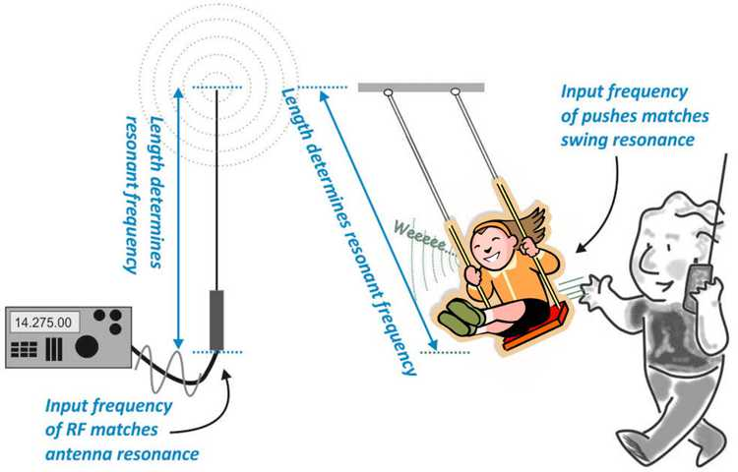
Resonance

Slide 11
Antenna Resonance
Antennas are resonant at specific frequencies.
  Many antennas are resonant at multiple frequencies
  When an antenna is resonant, its impedance is purely resistive, with no reactance component
  The farther from the resonant frequency, the less resonant the antenna will be and the SWR will be higher
Most transceivers have a 50 Ohm output impedance
We want our antenna to have a 50 Ohm impedance at the frequency we are currently operating on

Slide 12
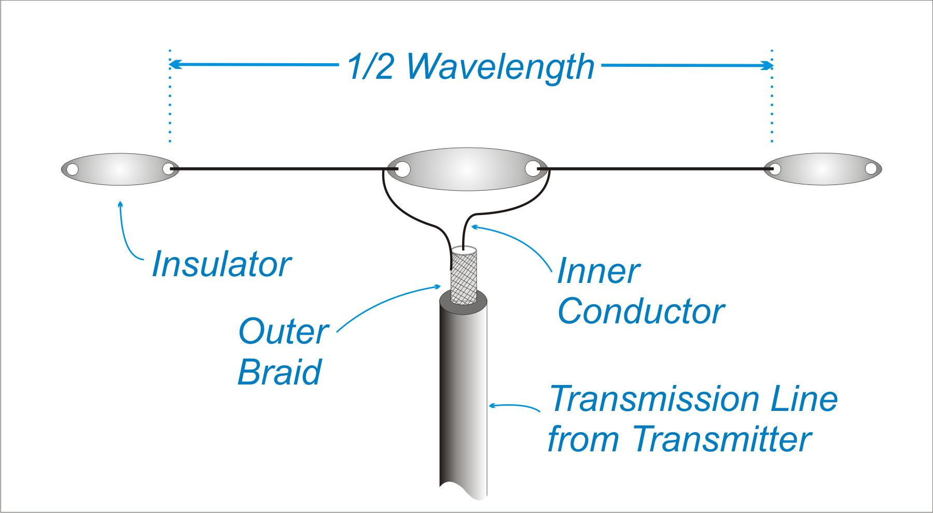
Center-fed Half-wave Dipole Antenna
This antenna has an impedance of 75 Ohm, purely resistive
The SWR is 75:50, 1.5:1 or 1.5
  This provides good transmission efficiency at its resonant frequency
  A good match between the receiver and the antenna
  If you operate at only the resonant frequency of this antenna, you don’t need a tuner
  This says nothing about how good this antenna is at radiating
This assumes that the antenna is the perfect height above the ground (approximately 60% of the wavelength)
What happens when the transmission
frequency is not the resonant frequency?

Slide 13
General Types of Antenna Tuners
Internal (part of the transceiver), typically up to 3:1 SWR
Manual
  Total control almost unlimited matching capability
  Difficult to use, every change in frequency requires an adjustment
Automatic
  Typically up to 10:1 SWR
  Easy to use, remembers settings

Slide 14
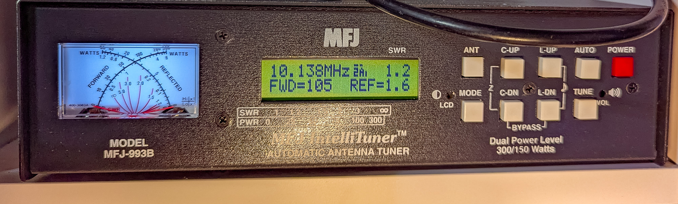
MFJ-993B Automatic Antenna Tuner

Slide 15
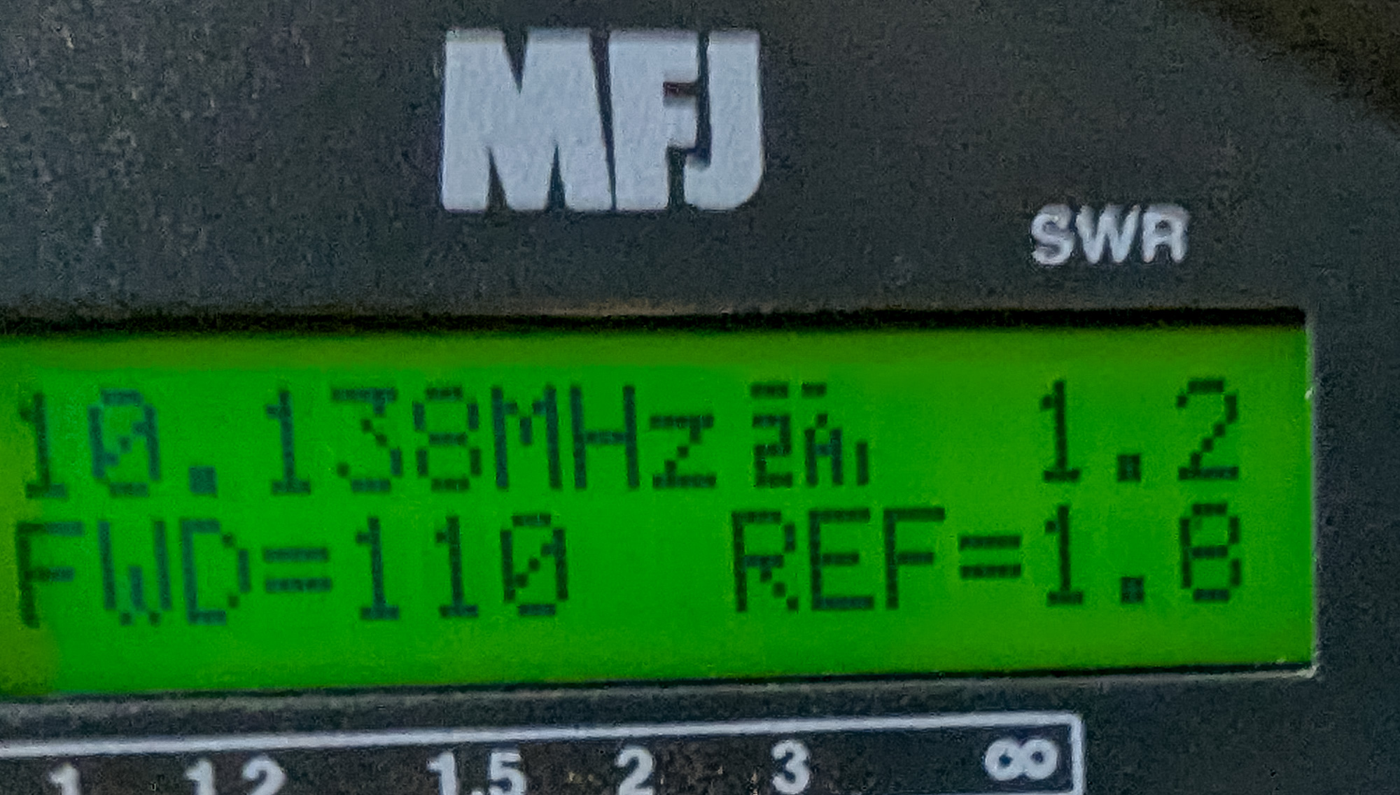

Slide 16
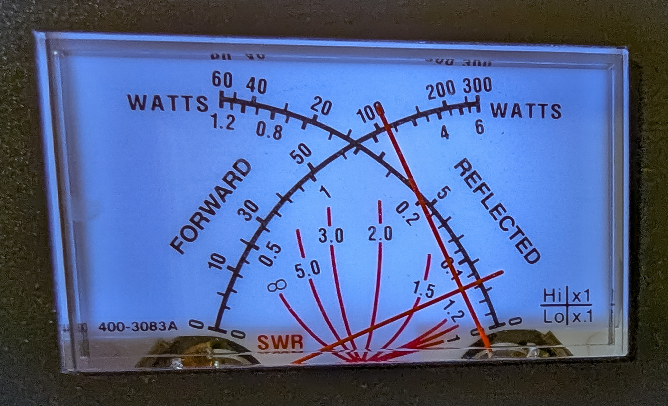

Slide 17
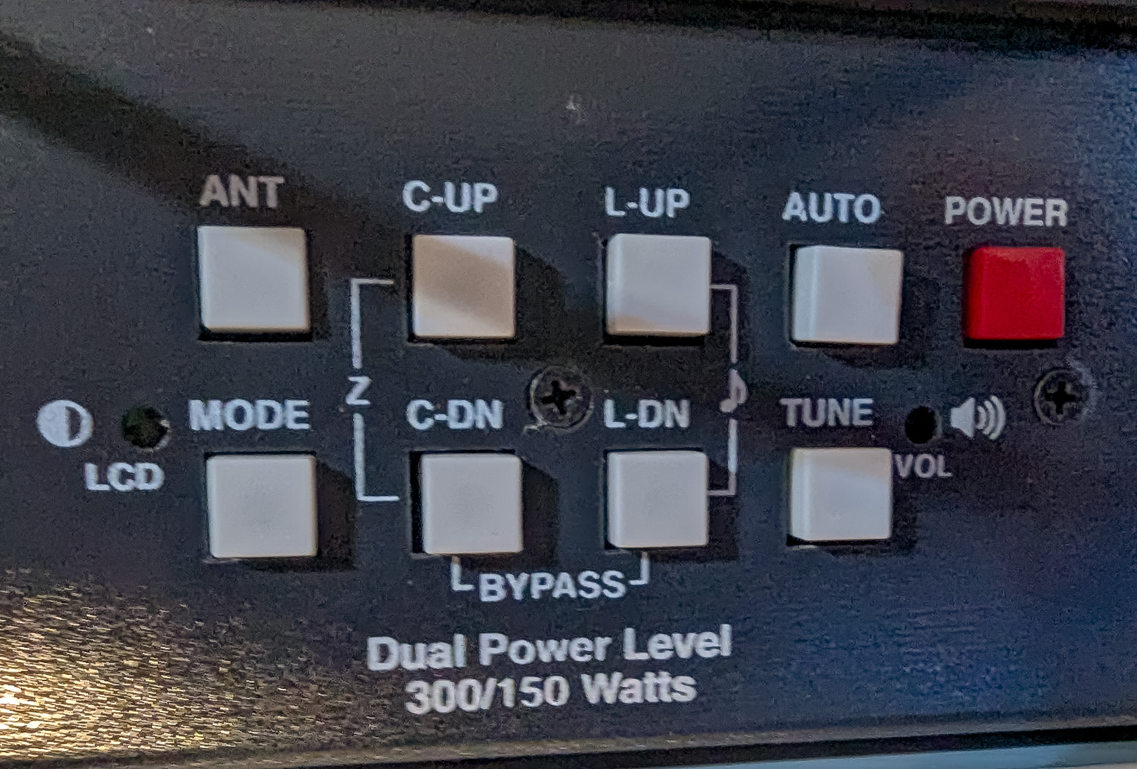

Slide 18
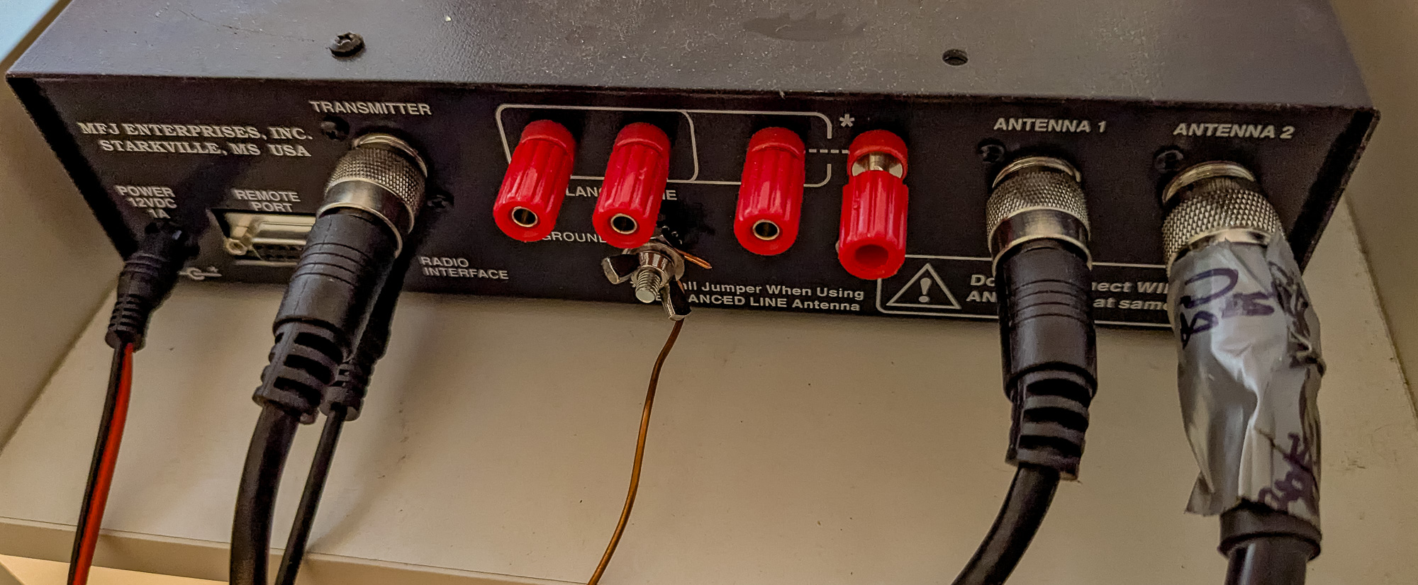

Slide 19
MFJ-993B Automatic Antenna Tuner
Likes:
  Easy to use
  On my 80m end-fed half-wave antenna, tunes all ham frequencies from 80m to 10m
  Digital display is very useful
Dislikes:
  On 17m and 12m SWR 2.5:1
Recommendations:
  I would buy it again for this antenna
  On Buddihex internal tuner works great

Slide 20
Questions?

Slide 21
Member overviews of their Antenna Tuner

